Slide 1
ELEMENTARY STATISTICS, BLUMAN
TI Calculator - Normal Probability (1 of 3)
© 2019 McGraw-Hill Education. All rights reserved. Authorized only for instructor use in the classroom. No reproduction or further distribution permitted without the prior written consent of McGraw-Hill Education.

Slide 2
Objectives for this PowerPoint
How to use the TI Graphing Calculator to find a probability associated with a normally distributed random variable

Slide 3

Problem
According to census.gov the average square footage of a house in the United States in the year 2015 was 2687 square feet. Assume that the square footage of US homes is a normally distributed variable with a standard deviation of 626 square feet. If a house in the US is selected at random, what is the probability that the square footage is less than 3651?
P(x < 3651)
$$z=\frac{x−μ}{σ}=\frac{3651−2687}{626}=1.54$$
We have calculated a z score and then using the normal distribution table determined that this probability would be .9382.

Slide 4
TI Graphing Calculator (1)
Let’s see how the TI graphing calculator can be used to arrive at the same result.

Slide 5
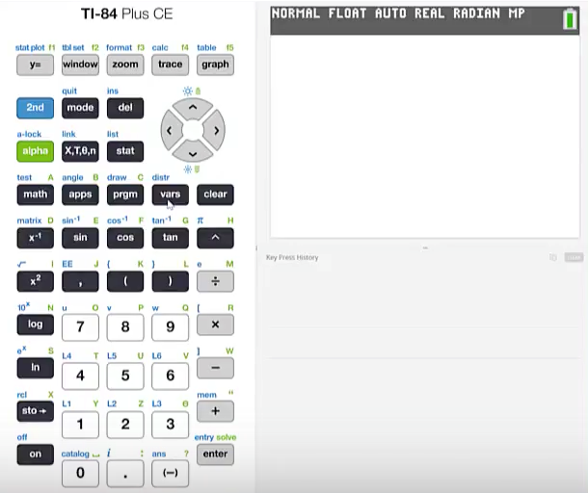
TI Graphing Calculator (2)
Press 2nd vars

Slide 6
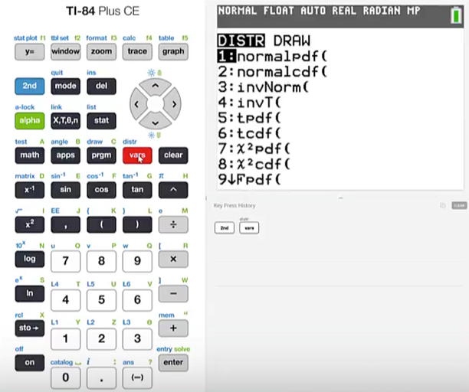
TI Graphing Calculator (3)
We’re going to use the normalcdf function so we'll press 2

Slide 7
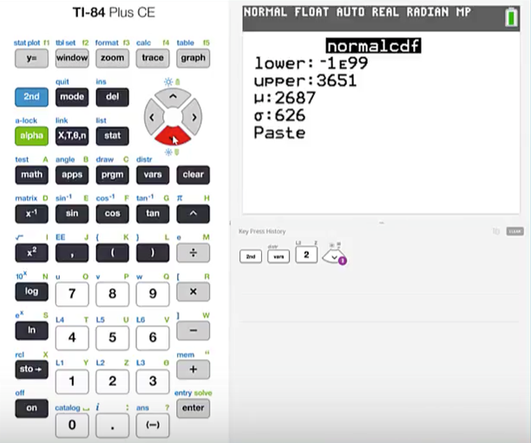
TI Graphing Calculator (4)
We are looking for the area under the normal curve to the left of a given value. So we should use -1E99 for our lower limit. For all practical purposes this value extends the distribution past the point where significant probabilities would reside. Our upper limit is 3651. The mean is 2687. The standard deviation is 626. Cursor to highlight paste and press enter.

Slide 8
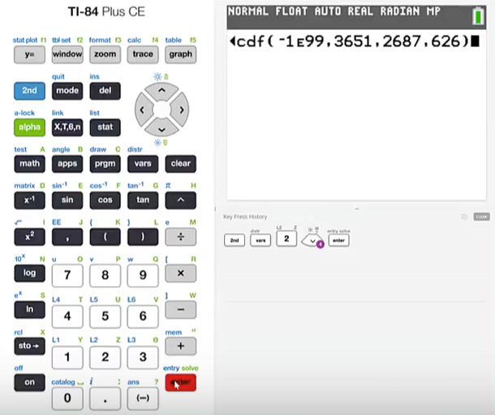
TI Graphing Calculator (5)
If you are using an older version of the TI graphing calculator you may not be presented with the menu. In that case the order that the values should take is lower limit, upper limit, mean, and standard deviation.
Press enter

Slide 9
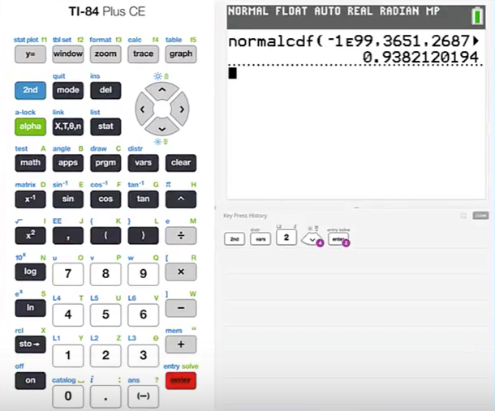
TI Graphing Calculator (6)
The calculator has determined that this probability would be .9382. This agrees with the probability that was determined using the normal probability table.

Slide 10
Summary
In this PowerPoint we learned how to use the TI Graphing Calculator to find a probability associated with a normally distributed random variable.

